Slide 1
Chapter 1 Introduction
A brief history of Internet
Protocols and standards
Standards organizations
Internet standards
Internet administration

Slide 2
1.1 A Brief History of Internet
1969. Four-node ARPANET established.
1970. ARPA hosts implement NCP.
1973. Development of TCP/IP suite begins.
1977. An internet tested using TCP/IP.
1978. UNIX distributed to academic/research sites.
1981. CSNET established.
1983. TCP/IP becomes the official protocol.
1983. MILNET was born.
1986. NSFNET established.
1990. ARPANET decommissioned and replaced by NSFNET.
1995. NSFNET goes back to being a research network.
1995. ISPs started.
Notes:
ARPANET：Advanced Research Project Agency Network
NCP：Network Control Protocol
MILNET：Military Network
NSFNET：National Science Foundation Network

Slide 3
Key Terms
Network，网络
A group of connected, communicating devices
internet / internetwork，互联网（网际网）
Two or more networks that can communicate with each other
互联形成的网络集合
interconnect，互联/互连
internetworking，网际互联/互连
Internet，因特网
The most notable internet in the world, running on TCP/IP

Slide 4
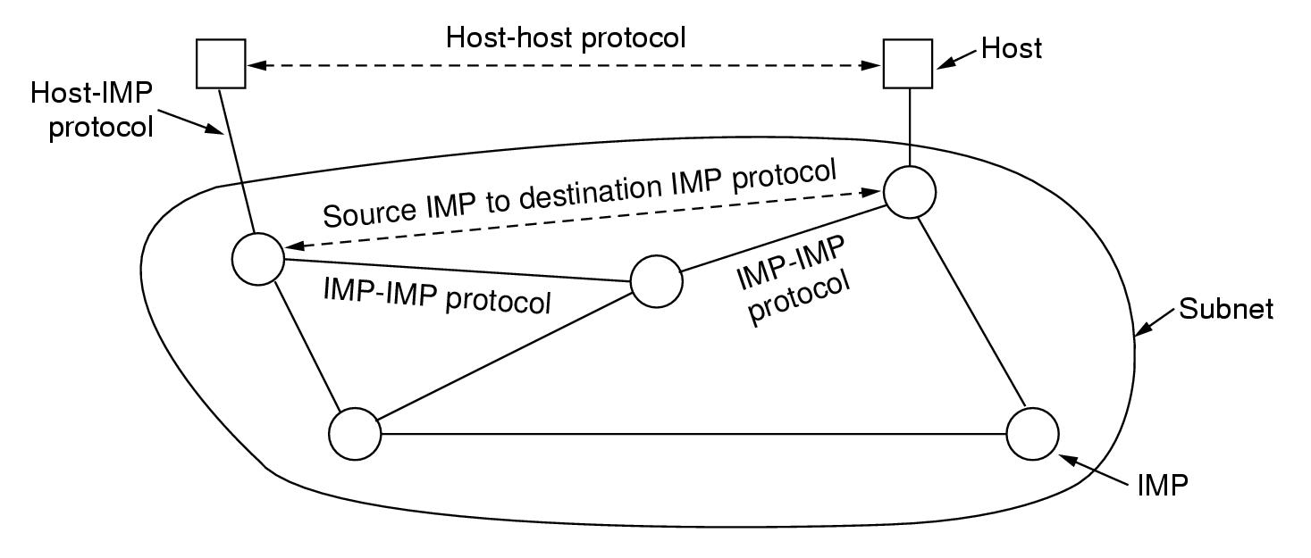
The Original ARPANET Design

Slide 5
Architecture of the Internet
Physical networks are interconnected by routers
Hosts are attached to one of the physical networks
R
R
R
R
R
R
R
Router
Physical network

Slide 6
如何看待互联网
用户角度
单一的虚拟网络
无需了解网络的内部结构
互联网角度
所有网络是平等的
路由器每个接口连接的都是网络
R
R
R
R
R
R

Slide 7
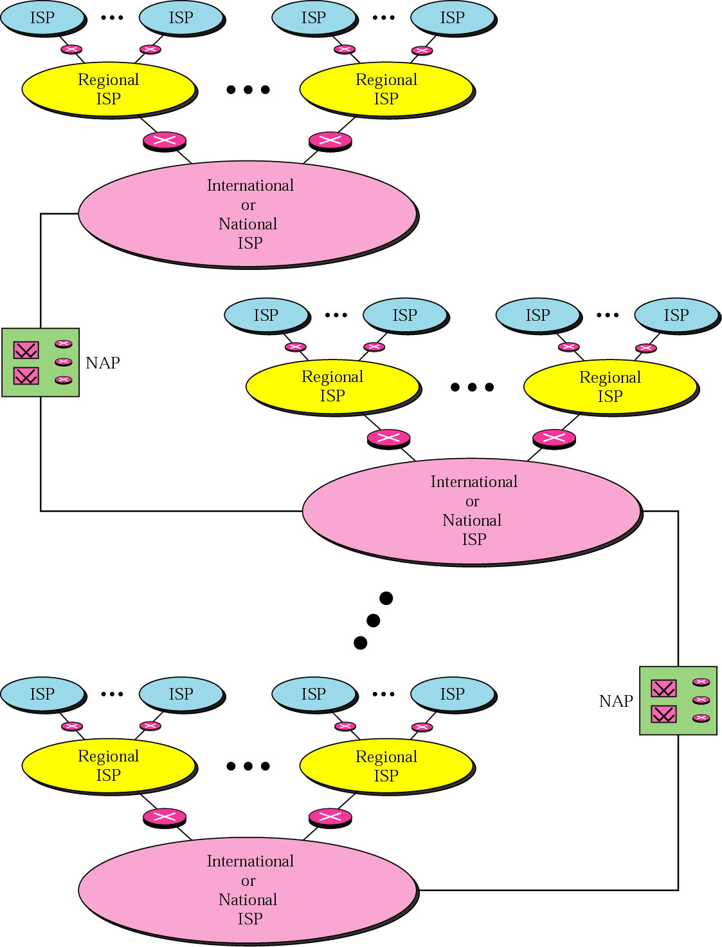
Internet Today
Notes:
NAP（NAP，network access point）是因特网的路由选择层次体系中的通信交换点，(1)通达因特网主干线的点。(2)因特网服务提供商(ISP)互相连接的点。

Slide 8
The Growing of Internet
Factor
New protocols
New technologies
More and more multimedia applications

Slide 9
1.2 Protocols and Standards
Protocol，协议
A set of rules that governs data communication
3 key elements
Syntax 语法、Semantics 语义 、Timing 时序
What、How、When
Standard，标准
Agreed-upon rules
Categories
De-facto 事实上的标准：by fact or by convention
De-jury 合法标准：by law or by regulation
同步：Synchronization

Slide 10
Analogy
Network | What is Flowing | Different Forms | Rules | Where
Highway | Vehicles | Trucks, cars, cycles | Traffic laws and rules for politeness | Roads and Highways
Postal | Objects | Letters, packages | Rules for packaging and attaching postage | Postal service-boxes, offices, trucks, planes, delivery people
Telephone | Information | Spoken languages | Rules for accessing phone and rules for politeness | Phone system-wires, EM waves, etc.

Slide 11
1.3 Standards Organizations
Standards Creation Committees
ISO（International Standards Organization，国际标准化组织）
ITU-T（International Telecommunications Union – Telecommunication Standardization Sector，国际电联 --电信标准部）
ANSI（American National Standards Institute，美国国家标准化局）
IEEE（Institute of Electrical and Electronics Engineering，电气电子工程师学会）
EIA（Electronic Industries Association，电子工业协会）
→ 行动缓慢，按章办事

Slide 12
Cont.
Forums
Frame Relay Forum（帧中继论坛）
ATM Forum（ATM论坛）
Regulatory Agencies
FCC（Federal Communications Commission，联邦通信委员会）
→ 加快标准化过程，测试、评价、标准化新技术
Internet标准—— RFC（Request For Comments）
http://www.rfc-editor.org

Slide 13
1.4 Internet Standards
RFC（Request For Comments）
请求评论、请求注解、请求注释
http://www.rfc-editor.org
The RFC document series is a set of technical and organizational notes about the Internet (originally the ARPANET), beginning in 1969. Memos in the RFC series discuss many aspects of computer networking, including protocols, procedures, programs, and concepts, as well as meeting notes, opinions, and sometimes humor.

Slide 14
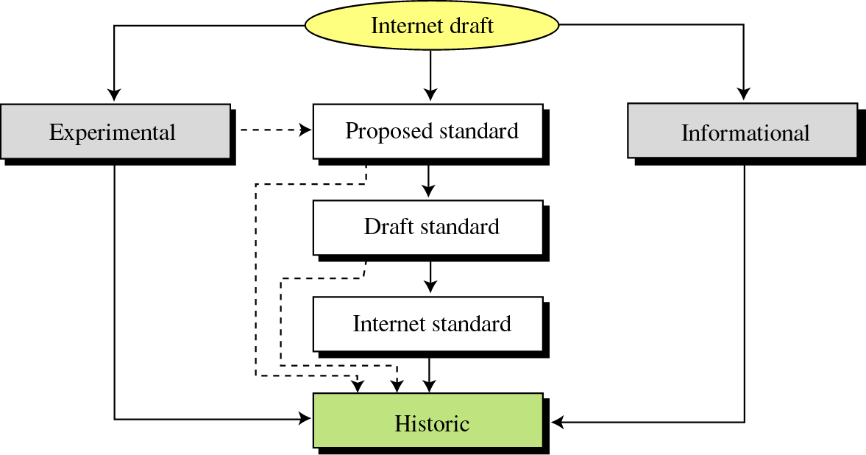
Maturity Levels of an RFC
RFC2026：The Internet Standards Process -- Revision 3

Slide 15
Example：RFC Index
0790 Assigned numbers. J. Postel. Sep-01-1981. (Format:
TXT=35316 bytes) (Obsoletes RFC0776) (Obsoleted
by RFC0820) (Status: HISTORIC)
0791 Internet Protocol. … (Status: STANDARD)
1256 ICMP Router Discovery Messages. … (Status:
PROPOSED STANDARD)
1460 Post Office Protocol - Version 3. … (Status: DRAFT
STANDARD)
1788 ICMP Domain Name Messages. … (Status:
EXPERIMENTAL)
1878 Variable Length Subnet Table For IPv4. … (Status:
INFORMATIONAL)

Slide 16
Requirement Levels of an RFC
RFC 2119 ：
Key words for use in RFCs to Indicate Requirement Levels
Required
Recommended
Elective
Requirement levels
Limited use
Not recommended
"MUST", "MUST NOT", "REQUIRED", "SHALL", "SHALL NOT", "SHOULD", "SHOULD NOT", "RECOMMENDED", "MAY", and "OPTIONAL"

Slide 17
1.5 Internet Administration
ISOC
Internet Society
因特网协会
IRTF：Internet Research Task Force
因特网研究部
Internet Architecture Broad
因特网体系结构研究委员会
IAB
IRTF
IRSG
IETF
IESG
…
Area
Area
…
…
…
RG
RG
WG
WG
WG
WG
IETF：Internet Engineering Task Force，因特网工程部
IANA：Internet Assigned Numbers Authority，因特网编号管理局
ICANN： Internet Corporation of Assigned Names and Numbers

Slide 18
1.6 Summary
Protocol（协议）
概念，要素
Standard（标准）
概念，种类
Internet
标准：RFC
历史、结构、管理机构
区别
Internet vs. internet

